Slide 1
Digital Image Processing
Lecture 2

Slide 2
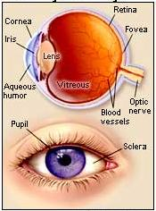
Structure of Human Eye

Slide 3
Structure of Human Eye
Human Eye –
The reflected light from the object enters the external
layer that coats the front of the eye, which is called the
cornea.
Afterwards, the light passes through some watery fluid
namely the aqueous humor.
Then the light reaches the iris that may contract
or dilate so as to limit or increase the amount of light
that strikes the eye.
Passing through the iris, the light now arrives at the pupil,
A black dot in the centre of the eye, and then reaches the
lens. The lens can change its shape in order to obtain focus
on reflected light from the nearer or further objects.

Slide 4
Structure of Human Eye
When the eye is properly focused, light from an object outside the eye is imaged on the retina
Two kinds of light receptors distribute on the retina, cones and rods
  Cones are primarily located in the central portion of the retina, called fovea and are sensitive to color; they perform best in relatively bright light; so, cone vision is called bright‐light vision
  Rods are distributed over the retinal surface; rods serve to give a general overall picture of the field of view; they are not involved in color vision and are sensitive to low levels of illumination; rod vision is called dim‐light vision

Slide 5
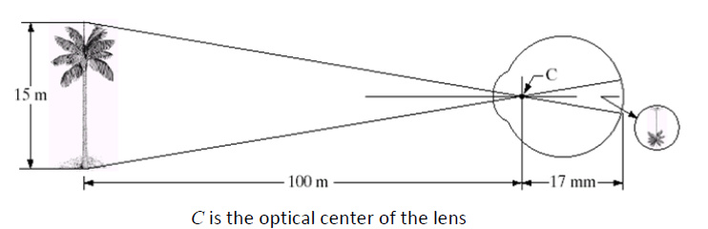
Image Formation in the Eye
An image is focused onto the retina
to become excited which ultimately send signals to the brain

Slide 6
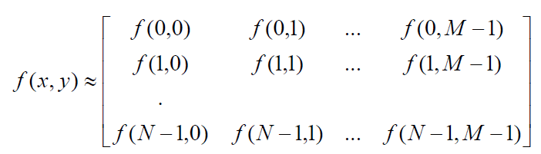
Image Sampling and Quantization
To be suitable for computer processing an image, f(x,y) must be digitized both spatially and in amplitude
Digitizing the spatial coordinates is called image sampling
Amplitude digitization is called gray-level quantization
f(x,y) is approximated by equally spaced samples in the form of an NxM array where each element is a discrete quantity

Slide 7



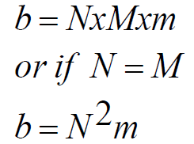
Image Sampling and Quantization
Common practice is to let N and M be powers of two; N= and
M=
And G= where G denotes the number of gray levels
The number of bits, b, necessary to store the image is then
For example, a 128x128 image with 64 gray levels would require 98,304 bits of storage
B/W: 128x128x1bit
Gray Level: 128x128x6bit
Color: 128x128x3x6bit

Slide 8
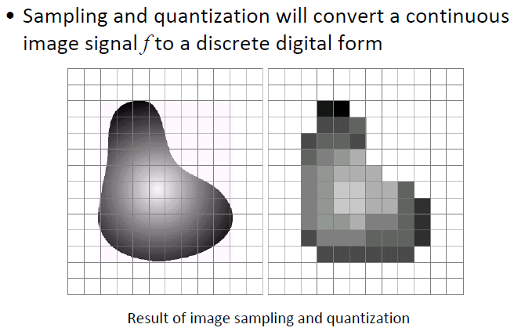
Image Sampling and Quantization
An image consists of an indefinite number of points with
continuous coordinates and amplitudes. To convert this image
to digital form, both the image coordinates and amplitudes
must be discretized.

Slide 9

Image Sampling and Quantization
y (intensity values)
a | b
c | d
Generating a digital image. (a) Continuous image. (b) A scaling line from A to B in the continuous image, used to illustrate the concepts of sampling and quantization. (c) sampling and quantization. (d) Digital scan line.

Slide 10

Representation of Digital Image
0 | 0 | 0 | 75 | 75 | 75 | 128 | 128 | 128 | 128
0 | 75 | 75 | 75 | 128 | 128 | 128 | 255 | 255 | 255
75 | 75 | 75 | 200 | 200 | 200 | 255 | 255 | 255 | 200
128 | 128 | 128 | 200 | 200 | 255 | 255 | 200 | 200 | 200
128 | 128 | 128 | 255 | 255 | 200 | 200 | 200 | 75 | 75
175 | 175 | 175 | 225 | 225 | 225 | 75 | 75 | 75 | 100
175 | 175 | 100 | 100 | 100 | 225 | 225 | 75 | 75 | 100
75 | 75 | 75 | 35 | 35 | 35 | 0 | 0 | 0 | 35
35 | 35 | 35 | 0 | 0 | 0 | 35 | 35 | 35 | 75
75 | 75 | 75 | 100 | 100 | 100 | 200 | 200 | 200 | 200

Slide 11
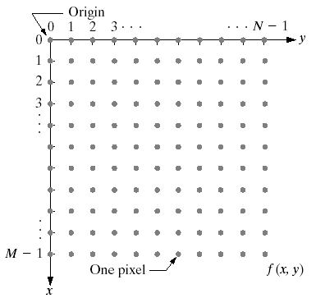
Representation of Digital Image
An image is normally represented in matrix form, originating from the upper left corner.
An image is a function defined on a 2D coordinate f(x,y).
The value of f(x,y) is the intensity.
3 such functions can be defined for a color image, each represents one color component

Slide 12
Image Sampling and Quantization
Spatial resolution
• The spatial resolution of an image is determined by how
sampling was carried out
Measuring spatial resolution
Since the spatial resolution refers to clarity, so for different devices, different measure has been made to measure it.

Slide 13
Measuring spatial resolution
Dots per inch
Dots per inch or DPI is usually used in monitors.
Lines per inch
Lines per inch or LPI is usually used in laser printers.
Pixel per inch
Pixel per inch or PPI is measure for different devices such as tablets , Mobile phones e.t.c.
(c) 2002-2004 by Yu Hen Hu

Slide 14
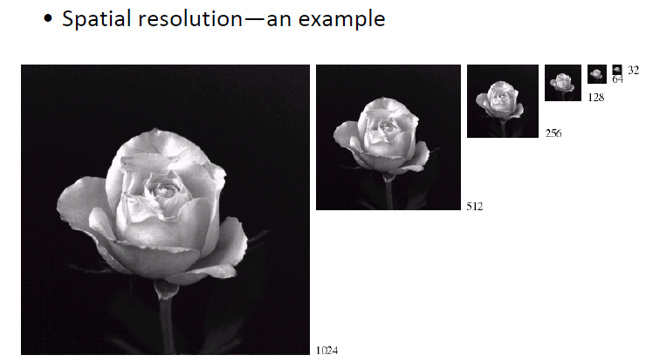
Image Sampling and Quantization

Slide 15
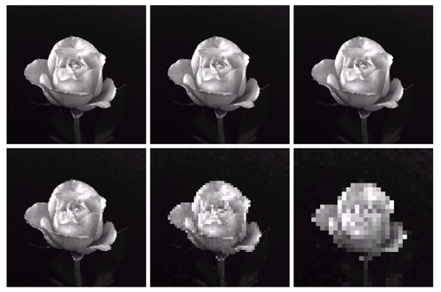
Image Sampling and Quantization

Slide 16
Intensity Level Resolution
Intensity level resolution refers to the number of intensity levels used to represent the image
  The more intensity levels used, the finer the level of detail discernable in an image
  Intensity level resolution is usually given in terms of the number of bits used to store each intensity level
Number of Bits
Number of Intensity Levels
Examples
1
2
0, 1
2
4
00, 01, 10, 11
4
16
0000, 0101, 1111
8
256
00110011, 01010101
16
65,536
1010101010101010

Slide 17


Intensity Level Resolution (cont…)
256 grey levels (8 bits per pixel)
128 grey levels (7 bpp)
64 grey levels (6 bpp)
32 grey levels (5 bpp)
16 grey levels (4 bpp)
8 grey levels (3 bpp)
4 grey levels (2 bpp)
2 grey levels (1 bpp)

Slide 18
Intensity Level Resolution (cont…)

Slide 19
Intensity Level Resolution (cont…)

Slide 20
Intensity Level Resolution (cont…)

Slide 21
Intensity Level Resolution (cont…)

Slide 22
Intensity Level Resolution (cont…)

Slide 23
Intensity Level Resolution (cont…)

Slide 24
Intensity Level Resolution (cont…)

Slide 25
Intensity Level Resolution (cont…)

Slide 26
Resolution: How Much Is Enough?
The big question with resolution is always how much is enough?
  This all depends on what is in the image and what you would like to do with it
  Key questions include
    Does the image look aesthetically pleasing?
    Can you see what you need to see within the image?

Slide 27

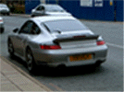
Resolution: How Much Is Enough? (cont…)
The picture on the right is fine for counting the number of cars, but not for reading the number plate

Slide 28
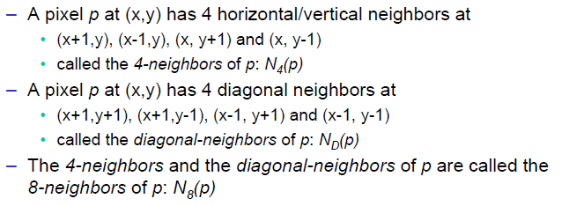
Basic relationships between pixels
An image is denoted by: f(x,y)
Lowercase letters (e.g. p, q) will denote individual pixels
A subset of f(x,y) is denoted by S Neighbors of a pixel:
 | (x, y-1)
(x-1, y) | P (x,y) | (x+1, y)
 | (x, y+1)

Slide 29
Basic relationships between pixels
The four diagonal neighbors of p have coordinates:
(x+1, y+1), (x+1, y-1), (x-1, y+1), (x-1, y-1)
and are denoted by N_{D} (p).
These points, together with the 4-neighbors, are called the 8-neighbors of p, denoted by N₈ (p).
(x-1, y-1) |  | (x+1, y-1)
 | P (x,y)
(x-1, y+1) |  | (x+1, y+1)
(x-1, y-1) | (x, y-1) | (x+1, y-1)
(x-1, y) | P (x,y) | (x+1, y)
(x-1, y+1) | (x, y+1) | (x+1, y+1)

Slide 30
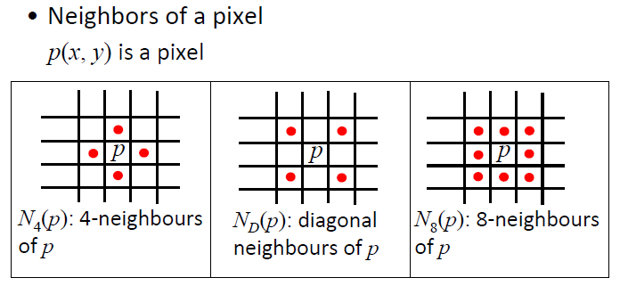
Basic Relationships between Pixels

